Slide 1
Doppler Radar
Ashton Knight, Kenn Brown, Liam Crowley, Ryan Gill

Slide 2
Requirements
Customer Requirements:
Build a speed gun using the HB-100 doppler radar module
Radar should have an accuracy of +/- 5 mph
Radar should have a friendly user interface
Radar should use radar signal processing to be able to accurately measure the speed of the vehicle
Our Added Requirements:
Radar should be able to measure speeds between 5 and 50 mph
Radar should be able to measure speeds of targets between a range of 5 feet and 50 feet

Slide 3
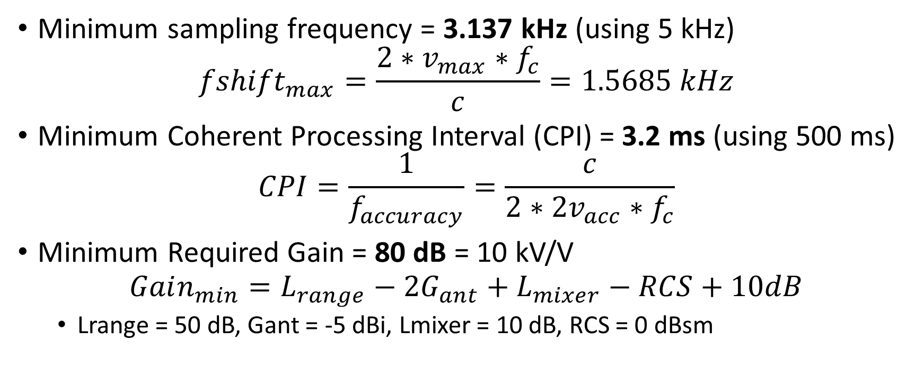
Specifications
Minimum sampling frequency = 3.137 kHz (using 5 kHz)
$${fshift}_{max}=\frac{2∗v_{max}∗f_{c}}{c}=1.5685 kHz$$
Minimum Coherent Processing Interval (CPI) = 3.2 ms (using 500 ms)
$$CPI=\frac{1}{f_{accuracy}}=\frac{c}{2∗2v_{acc}∗f_{c}}$$
Minimum Required Gain = 80 dB = 10 kV/V
$${Gain_{min}=L}_{range}−{2G}_{ant}+L_{mixer}−RCS+10dB$$
Lrange = 50 dB, Gant = -5 dBi, Lmixer = 10 dB, RCS = 0 dBsm

Slide 4
Block Diagram
Antenna
T/R Switch
Waveform Generation
Down converter
Amplification
Filters
A/D Converter
(Arduino Mega)
Display
Velocity Detection
FFT
Detection / Thresholding

Slide 5
Block Diagram
HB-100
Antenna
T/R Switch
Waveform Generation
Down converter
Amplification
Filters
A/D Converter
(Arduino Mega)
Display
Velocity Detection
FFT
Detection / Thresholding

Slide 6
Block Diagram
Antenna
T/R Switch
Waveform Generation
Down converter
Amplification
Filters
A/D Converter
(Arduino Mega)
Receiver
Display
Velocity Detection
FFT
Detection / Thresholding

Slide 7
Block Diagram
Antenna
T/R Switch
Waveform Generation
Down converter
Amplification
Filters
A/D Converter
(Arduino Mega)
Display
Velocity Detection
FFT
Detection / Thresholding
DSP

Slide 8
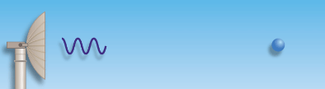
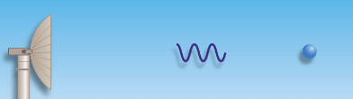
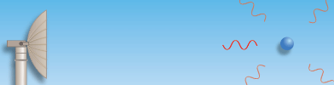
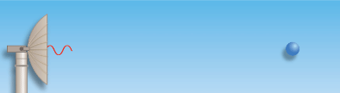
HB-100
Radar sends out a pulse
Pulse hits and reflects off of target
Radar receives reflected pulse
Measures frequency shift (doppler shift) to determine velocity of target

Slide 9
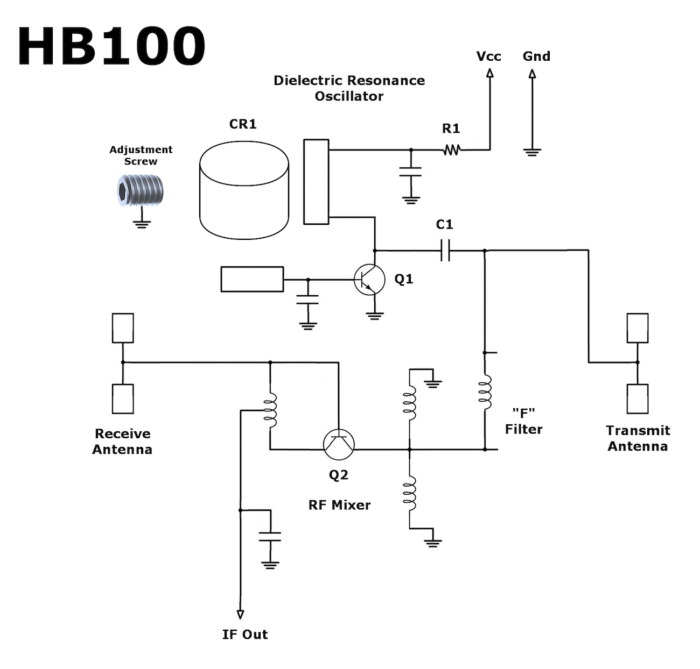
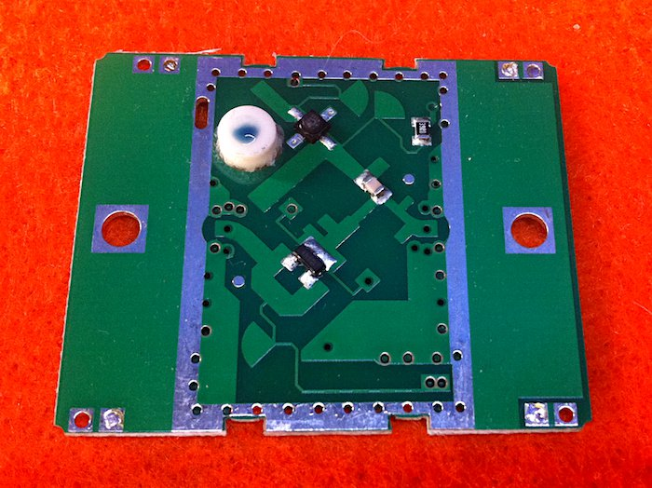

Slide 10
Signal Conditioning
Talk about AGC and filters (high pass to get rid of dc and low pass to get rid of anti-aliasing) on our PCB
Not Ryan

Slide 11
Target and Velocity Detection

Slide 12
Tracking

Slide 13
Results

Slide 14
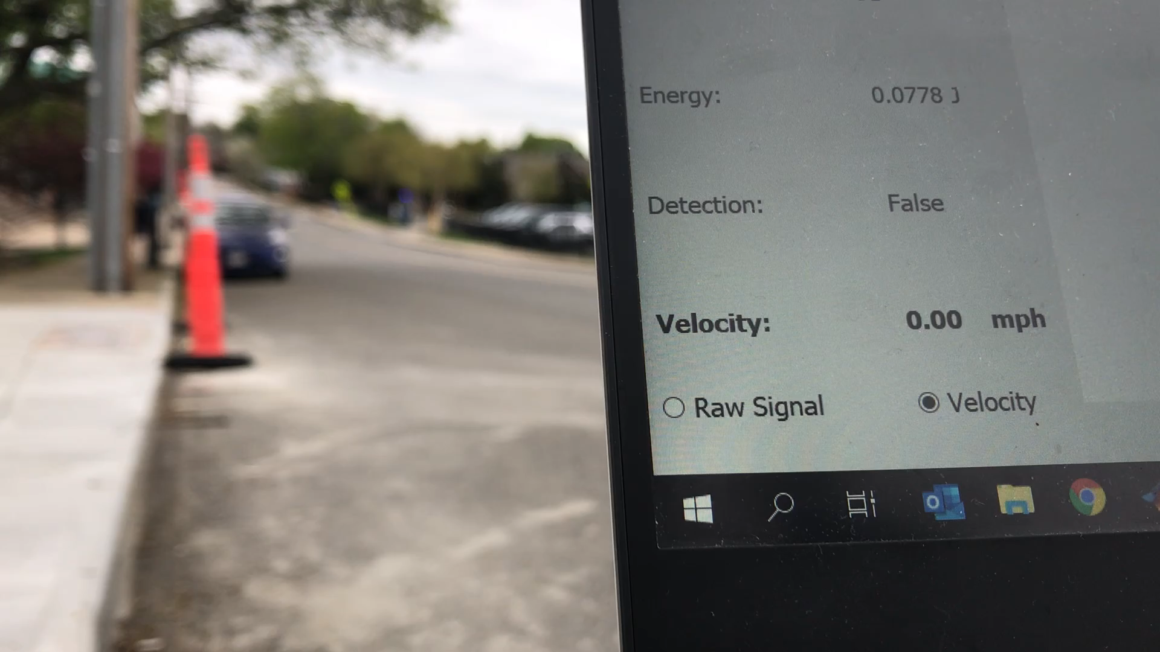
Results

Slide 15
Questions?

